Slide 1
Software Architecture
Quality Attributes

Slide 2
Quality Attribute Specification
Architects are often told:
“My application must be fast/secure/scale”
Far too imprecise
Quality attributes (QAs) must be made precise/measurable for a given system design, e.g.
“It must be possible to scale the deployment from an initial 100 geographically dispersed user desktops to 10,000 without an increase in effort/cost
for installation and configuration.”

Slide 3
What are Quality Attributes
Often know as –ilities
Performance
Security
Availability
Scalability
Usability
Reliability
Portability
Modifiability
Maintainability

Slide 4
Architecture and Quality Attributes
Achieving quality attributes must be considered throughout design, implementation, and deployment.
For example:
Usability involves both architectural and nonarchitectural aspects.
Making the user interface easy to use is nonarchitectural
providing the user with undo operations is architectural.

Slide 5
Architecture and Quality Attributes
For example:
Modifiability
how functionality is divided (architectural)
by coding techniques within a module (nonarchitectural).
Performance
how much communication is necessary among components and how shared resources are allocated (architectural)
the choice of algorithms and how they are coded (nonarchitectural)

Slide 6
Architectural conflicts
Within complex systems, the achievement of quality attributes affect each other.
Sometimes the effect is positive and sometimes negative.
For example,
Using large-grain components improves performance but reduces maintainability.
Introducing redundant data improves availability but makes security more difficult.
Localizing safety-related features usually means more communication so degraded performance.

Slide 7
Quality Attribute Scenarios
A quality attribute scenario is a quality- attribute-specific requirement. It consists of six parts.
Source of stimulus – the entity that generated the stimulus
Stimulus – a condition that needs to be considered when it arrives at a system
Environment – the particular conditions in which the stimulus occurs

Slide 8
Quality Attribute Scenarios
The six parts of a quality attribute scenario.
Artifact – the system or the pieces of it that are stimulated
Response – the activity undertaken after the arrival of the stimulus
Response measure – when the response occurs, it should be measurable in some fashion so that the requirement can be tested.

Slide 9
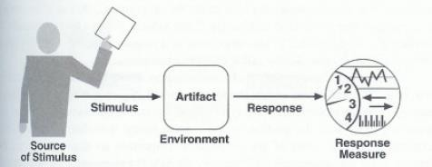
Quality Attribute Parts

Slide 10
General vs. Concrete Quality Attribute Scenarios
A general scenario is system independent and can, potentially, pertain to any system.
A concrete scenario is specific to the particular system under consideration.
Concrete scenarios are needed to make the quality requirements operational.

Slide 11
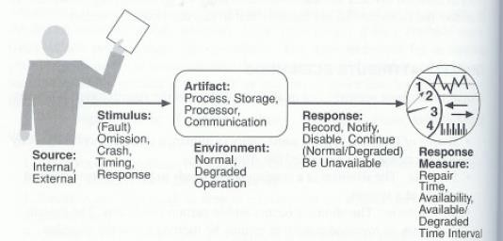
General Scenario for Availability

Slide 12
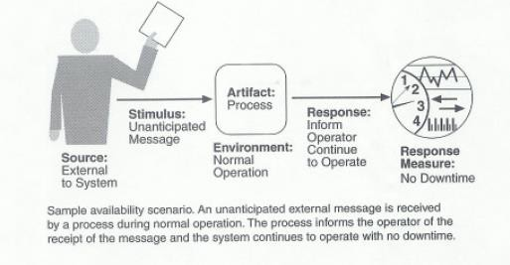
Sample Concrete Availability Scenario

Slide 13
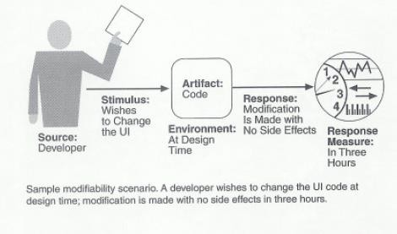
Sample Modifiability Scenario

Slide 14
Features of Concrete Scenarios
A collection of concrete scenarios can be used as the quality attribute requirements of a system.
Each scenario is concrete enough to be meaningful to the architect.
The details of the responses are meaningful enough so that it is possible to test whether the system has achieved the response.

Slide 15
Features of Concrete Scenarios
Concrete scenarios play the same role in the specification of quality attributes that use cases play in the specification of functional requirements.

Slide 16
Quality Attribute Scenario Generation
Theoretically quality attribute requirements should be obtained during requirements analysis, but in practice is seldom done.
It is the architect’s task to ensure that this is accomplished by generating concrete quality attribute scenarios.
Quality-attribute-specific tables are used to create general scenarios and from them concrete scenarios are specified.

Slide 17
Generation of General Availability Scenario
Portion of Scenario | Possible Values
Source | Internal to the system; external to the system
Stimulus | Fault; omission, crash, timing, response
Artifact | System’s processors, communication channels, persistent storage processes
Environment | Normal operation; degraded mode (i.e., fewer features, a fall-back solution.)
Response | System should detect event and do one or more of the following: record it notify appropriate parties, including the user and other systems disable sources of events that cause fault or failure be unavailable for a prespecified interval continue to operate in normal or degraded mode
Response Measure | Time interval when the system must be available; availability time; time interval in which system can be in degraded mode; repair time

Slide 18
Quality Attribute Scenario Generation
The tables serve as checklist to ensure that all possibilities have been considered.
It doesn’t matter to generate the same or similar scenarios from different quality attributes as the redundancies can easily be removed.
The important is that no important requirements are omitted.

Slide 19
Quality Attribute Scenarios in Practice
The general scenario approach provides a framework for generating a large number of system-independent, quality-attribute-specific scenarios.
To make the general scenarios useful, you must make them system specific.

Slide 20
Performance
Many examples of poor performance in enterprise applications
Performance requires a:
Metric of amount of work performed in unit time
Deadline that must be met
Enterprise applications often have strict performance requirements, e.g.
1000 transactions per second
3 second average latency for a request
Localize critical operations and minimize communications. Use large rather than fine-grain components.

Slide 21
Table for Generation of General Performance Scenario
Portion of Scenario
 | Possible Values
Source | One of a number of independent sources, possibly from within system
Stimulus | Periodic events arrive; sporadic events arrive; stochastic events arrive
Artifact | System
Environment | Normal mode; overload mode
Response | Processes stimuli; changes level of service
Response Measure | Latency, deadline, throughput, miss rate, data loss

Slide 22
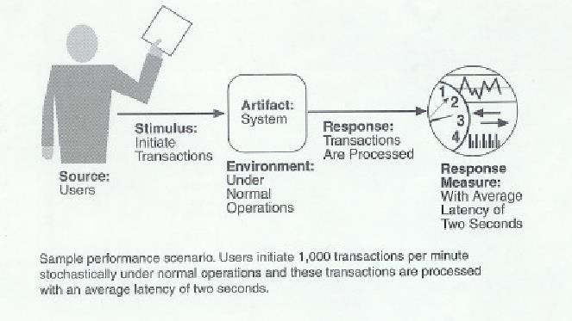
Sample Performance Scenario

Slide 23
Performance - Throughput
Measure of the amount of work an application must perform in unit time
Transactions per second
Messages per minute
Is required throughput:
Average?
Peak?

Slide 24
Performance - Response Time
measure of the latency an application exhibits in processing a request
Usually measured in (milli)seconds
Is required response time:
Guaranteed?
Average?

Slide 25
Performance - Deadlines
something must be completed before some specified time
Payroll system must complete by 2am so that electronic transfers can be sent to bank
Weekly accounting run must complete by 6am Monday so that figures are available to management
Deadlines are often associated with batch jobs in IT systems.

Slide 26
Scalability
Scalability is a desirable property of a system, a network, or a process, which indicates its ability to either handle growing amounts of work in a graceful manner or to be readily enlarged.
4 common scalability issues in IT systems:
Request load
Connections
Data size
Deployments

Slide 27
Scalability – Request Load
How does an 100 tps application behave when simultaneous request load grows?
From 100 to 1000 requests per second?
Ideal solution, without additional hardware capacity:
as the load increases, throughput remains constant (i.e. 100 tps), and response time per request increases only linearly (i.e. 10 seconds).

Slide 28
Scalability – Add more
hardware …
Scale-out:
Application
Scale-up:
Single application instance is executed on a multiprocessor machine
replicated on different machines
Application
Application
CPU
Application
Application
Application

Slide 29
Scalability - connections
What happens if number of simultaneous connections to an application increases
If each connection consumes a resource?
Exceed maximum number of connections?

Slide 30
Scalability – Data Size
How does an application behave as the data it processes increases in size?
Chat application sees average message size double?
Database table size grows from 1 million to 20 million rows?
Image analysis algorithm processes images of 100MB instead of 1MB?
Can application/algorithms scale to handle increased data requirements?

Slide 31
Scalability - Deployment
How does effort to install/deploy an application increase as installation base grows?
Install new users?
Install new servers?
Solutions typically revolve around automatic download/installation
E.g. downloading applications from the Internet

Slide 32
Scalability thoughts
Scalability often overlooked.
Major cause of application failure
Hard to predict
Hard to test/validate
Reliance on proven designs and technologies is essential

Slide 33
Modifiability
Modifications to a software system during its lifetime are a fact of life.
Modifiable systems are easier to change/evolve
Modifiability should be assessed in context of how a system is likely to change
No need to consider changes that are highly unlikely to occur
Modifiability is about the cost of change.

Slide 34
Modifiability
Modifiability measures how easy it may be to change an application to cater for new (non-) functional requirements.
‘may’ – nearly always impossible to be certain
Must estimate cost/effort

Slide 35
Modifiability Analysis
Impact is rarely easy to quantify
The best possible is a:
Convincing impact analysis of changes needed
A demonstration of how the solution can accommodate the modification without change.

Slide 36
Modifiability Analysis
Minimizing dependencies increases modifiability
Changes isolated to single components likely to be less expensive than those that cause ripple effects across the architecture.

Slide 37
Security
Security Properties
Authentication: Applications can verify the identity of their users and other applications with which they communicate.
Authorization: Authenticated users and applications have defined access rights to the resources of the system.
Encryption: The messages sent to/from the application are encrypted.

Slide 38
Security
Integrity: This ensures the contents of a message are not altered in transit.
Non-repudiation: The sender of a message has proof of delivery and the receiver is assured of the sender’s identity. This means neither can subsequently refute their participation in the message exchange, i.e. a transaction cannot be denied by any of the parties to it.
Auditing: the property that the system tracks activities within it at levels sufficient to reconstruct them.

Slide 39
Security Specifics
Security is a measure of the system’s ability to resist unauthorized usage while providing its services to legitimate users.
An attempt to breach security is an attack – it could be to gain access to data or services or to deny service to others.

Slide 40
Table for Generation of General Security Scenario
Portion of Scenario | Possible Values
Source | Individual or system that is correctly identified, identified incorrectly, of unknown identity who is internal/external, authorized/not authorized with access to limited resources, vast resources
Stimulus | Tries to display data, change/delete data, access system services, reduce availability to system services
Artifact | System services; data within system
Environment | Either online or offline, connected or disconnected, firewalled or open
Response | Authenticates user; hides identity of the user; blocks access to data and/or services; allows access to data and/or services; grants or withdraws permission to access data and/or services; records access/modifications or attempts to access/modify data/services by identity; stores data in an unreadable format; recognizes an unexplainable high demand for services, and informs a user or another system, and restricts availability of services
Response Measure | Time/effort/resources required to circumvent security measures with probability of success; probability of detecting attack; probability of identifying individual responsible for attack or access/modification of data and/or services; percentage of services still available under denial-of-services attack; restore data/services; extent to which data/services damaged and/or legitimate access denied

Slide 41
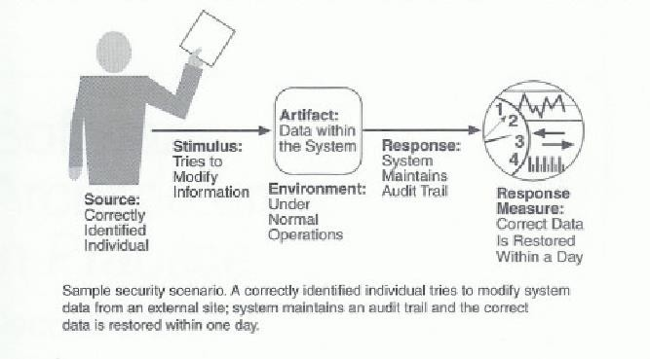
Sample Security Scenario

Slide 42
Availability
Availability is concerned with system failure and its consequences.
Key requirement for most IT applications
Measured by the proportion of the required time it is useable.
100% available during business hours
No more than 2 hours scheduled downtime per week
24x7x52 (100% availability)
Related to an application’s reliability
Unreliable applications suffer poor availability

Slide 43
Availability
Period of loss of availability determined by:
Time to detect failure
Time to correct failure
Time to restart application
Strategies for high availability:
Eliminate single points of failure
Replication and failover
Automatic detection and restart
Recoverability
the capability to reestablish performance levels and recover affected data after an application or system failure
43

Slide 44
Availability Specifics
Areas of concern:
How the system failure is detected
How frequently system failures occur
What happens when a failure occurs
How long a system is allowed to be out of operation
When failures may occur safely
How failures can be prevented
What kinds of notifications are required when a failure occurs
44

Slide 45
Generation of General Availability Scenario
Portion of Scenario | Possible Values
Source | Internal to the system; external to the system
Stimulus | Fault; omission, crash, timing, response
Artifact | System’s processors, communication channels, persistent storage processes
Environment | Normal operation; degraded mode (i.e., fewer features, a fall-back solution.)
Response | System should detect event and do one or more of the following: record it notify appropriate parties, including the user and other systems disable sources of events that cause fault or failure be unavailable for a prespecified interval continue to operate in normal or degraded mode
Response Measure | Time interval when the system must be available; availability time; time interval in which system can be in degraded mode; repair time
45

Slide 46
Usability
Usability is concerned with how easy it is for the user to accomplish a desired task and the kind of user support provided.
Areas of usability:
Learning system features
Using a system efficiently
Minimizing the impact of errors
Adapting the system to user needs
Increasing confidence and satisfaction
46

Slide 47
G S
eneration of General Usability cenario
Portion of Scenario | Possible Values
Source | End user
Stimulus | Wants to learn system features; use system efficiently; minimize impact of errors; adapt system; feel comfortable
Artifact | System
Environment | At runtime or configuration time
Response | System provides one or more of the following responses: to support “learn system features” – help system is sensitive to context; interface is familiar to user; interface is usable in an unfamiliar context to support “use system efficiently” – aggregation of data and/or commands; re- use of already entered data and/or commands; support for efficient navigation within a screen; distinct views with consistent operations; comprehensive searching; multiple simultaneous activities to minimize “impact of errors” – undo, cancel, recover from system failure, recognize and correct user error, retrieve forgotten password, verify system resources to “adapt system” – customizability; internationalization to “feel comfortable” – display system state; work at the user’s pace
Response Measure Software System Architecture | Task time, number of errors, number of problems solved, user satisfaction, gain of user knowledge, ratio of successful operations to total operations; amount of ^{time/data lost} Xiaobin Xu 47

Slide 48
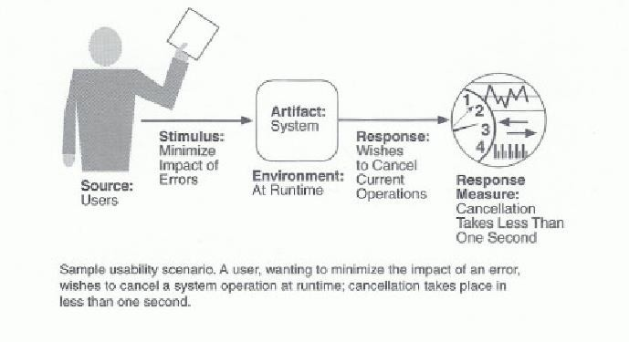
Sample Usability Scenario
48

Slide 49
Design Trade-offs
QAs are rarely orthogonal, they interact and affect each other
Architects must create solutions that makes sensible design compromises
not possible to fully satisfy all competing requirements
Must satisfy all stakeholder needs
49

Slide 50
Summary
QAs are part of an application’s non- functional requirements
Many QAs
Architect must decide which are important for a given application
Understand implications for application
Understand competing requirements and trade-offs.
50

